Slide 1
K Means Algorithm

Slide 2
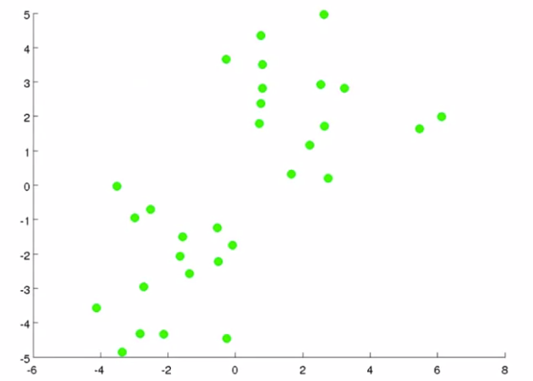
Problem Statement
Given an unlabeled dataset, group into clusters

Slide 3
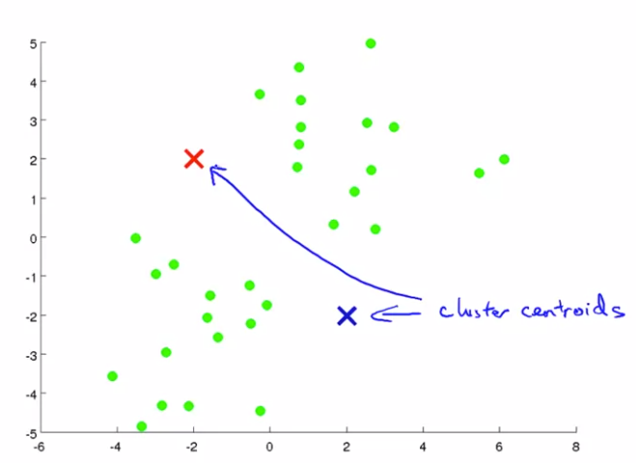
K Means Algorithms
Step 1: Randomly Initialize K Cluster centroids

Slide 4
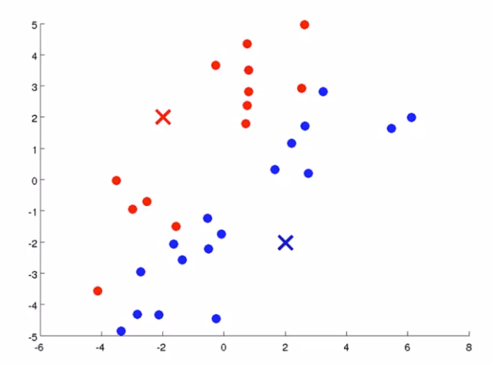
K Means Algorithms
Step 1: Randomly Initialize K Cluster centroids
Step 2: Assign data points to the closest centroid

Slide 5
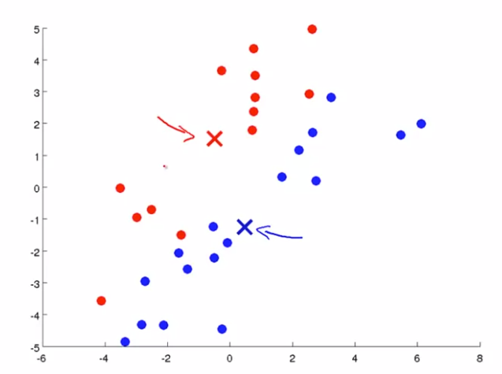
K Means Algorithms
Step 1: Randomly Initialize K Cluster centroids
Step 2: Assign data points to the closest centroid
Step 3: For each cluster, move the centroid to the mean of all the data points belong to that cluster

Slide 6
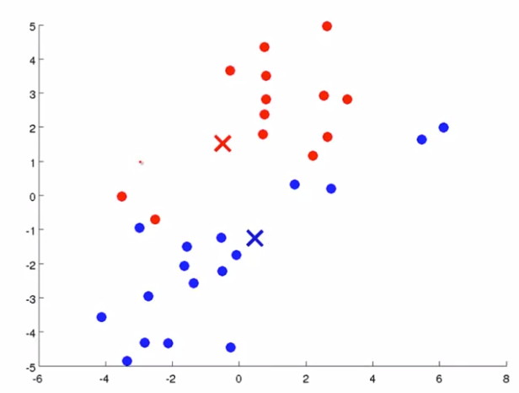
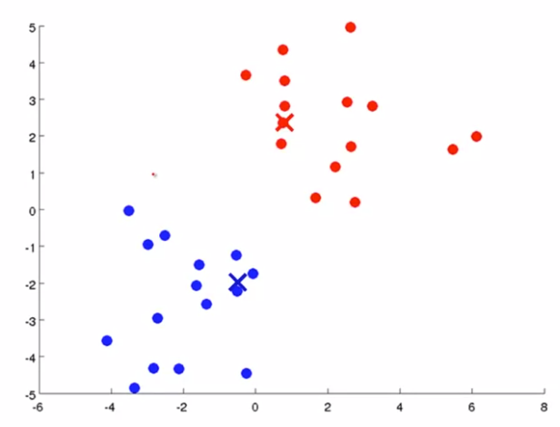
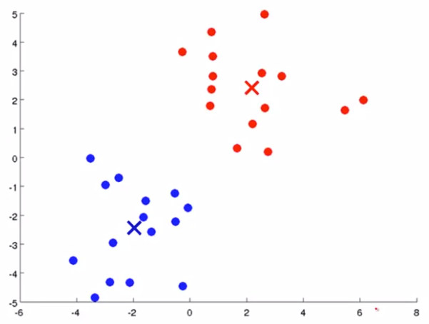
K Means Algorithms
Step 1: Randomly Initialize K Cluster centroids
Step 2: Assign data points to the closest centroid
Step 3: For each cluster, move the centroid to the mean of all the data points belong to that cluster
Step 4: Repeat from step 2

Slide 7
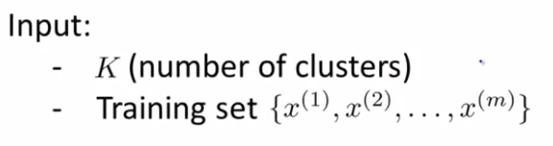

K Means Algorithm

Slide 8
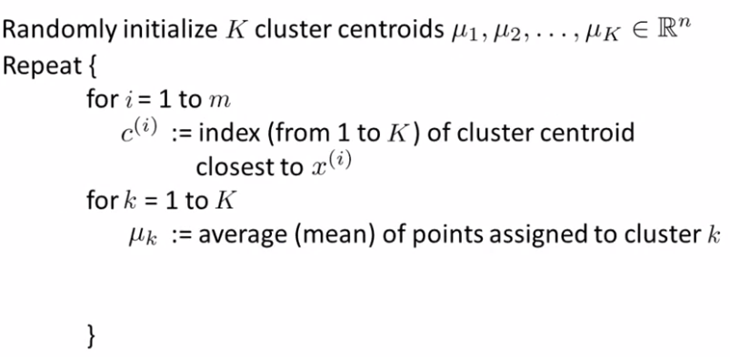
K Means Algorithm

Slide 9
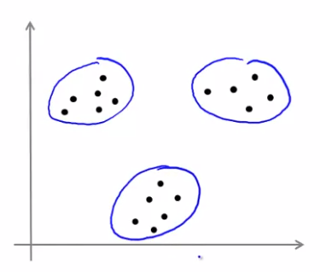
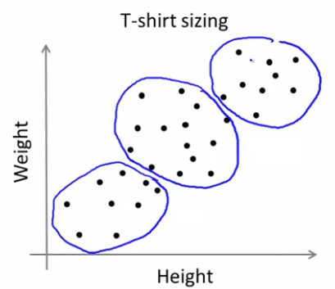
K Means for non-separated clusters
Separated clusters
Non-Separated clusters

